Slide 1
The Importance of Big Data in the Future of Computer Science
Sandra Fernando

Slide 2
Outline
What is Big Data?
Why Big Data?
Use Cases
Past and Present of Data
Challenge V1
Challenge V2
Challenge V3
Future of Computer Science

Slide 3
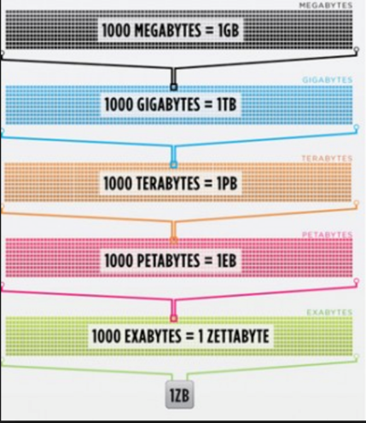
Velocity (Speed of Data)
Volume
Big Data
Value
Variety
Veracity
(Trustworthiness of Data)

Slide 4
What is Big Data ?
Data sets with sizes beyond the ability to commonly use software tools to capture, curate, manage and process within a tolerable elapsed time. Big Data requires a set of techniques and technologies with new forms of integration to reveal insights from datasets that are diverse, complex and of massive scale.
Batch
Ingest
Process
Persist
Extract
Ad Hoc
STORE DATA
Real-time
/Streaming

Slide 5
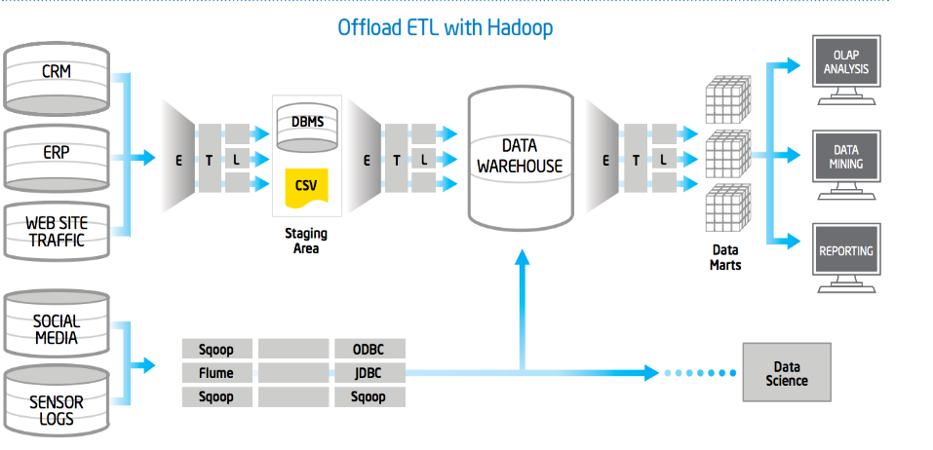

Slide 6
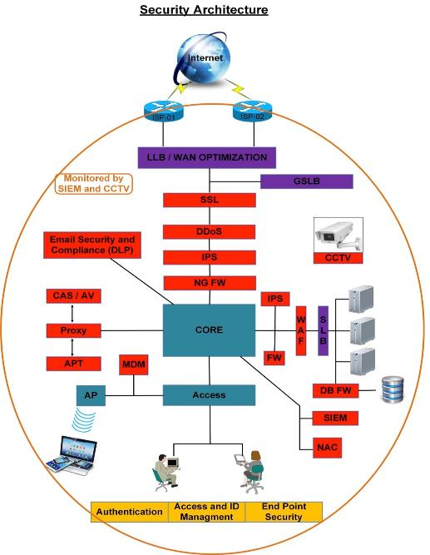
Usage of Big Data -Example 1
Jargon
LLB – Local Load Balance
GSLB – Global Server Load Balance
WAF – Web Applicatoin Firewall
SLB – Sever Load Balance
IPS – Intrusion Prevention System
FW – Firewall
SIEM - Security Information and Event Management

Slide 7
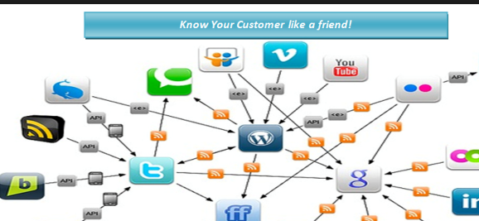
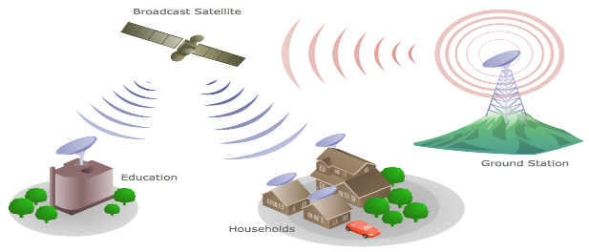
Usage of Big Data -Example 2

Slide 8
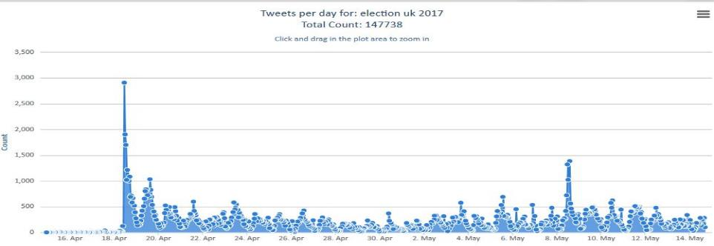
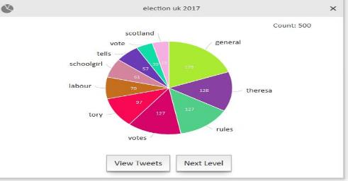
Data Visualization

Slide 9
What are the Big Questions ? (Real World Hadoop)
How do I optimise my Data Warehouse to run processes in an efficient cost effective manner as the system grows?
Can I get Customer 360 system to access customer histories?
Can I have a recommendation Engine to improve customer experience?
How do I optimise my market to understand what causes customers to buy products ?
How do I process my Log data such as performance, breakage or intrusions effectively?
Can I get a centralise Data Hub to provide access to developers, data scientists and business analysts ?

Slide 10
Big Data Use Case
Only with some courses
Are most viewed courses have best Grades on Moodle?
What courses are viewed on Moodle?
Some courses had no grade book element
What activities did they do on Moodle?
Some courses lack graded Moodle assessments ???
Students who viewed the course most got the best grade ?
Other best graded students had high Moodle usage times
Only with some Students

Slide 11
Why Do commonly used software not sufficient to handle Big Data?
DB are collection of structured data, DW are a collection of databases and BD are collection of any type of digital data.
DB and DW have single server implementation where BG span across multiple machines.
BG solution is a technology DW Data Warehousing is an architecture
DB has ACID properties whereas BD write once reads many times.
DB support SQL whereas BG support lightweight of SQL and unstructured Queries
DB relies on Schema on write whereas BD relies on schema on read rather that defining schema
DB brings data to a computer whereas BG brings computer to data
Databases (DB)
Data Warehouses(DW)
Big Data (BD)

Slide 12
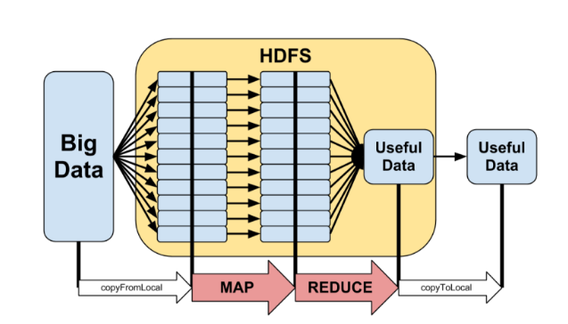
V1 -Volume

Slide 13
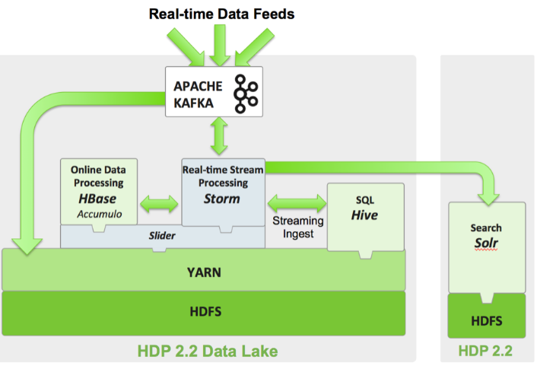
V2 -Velocity

Slide 14
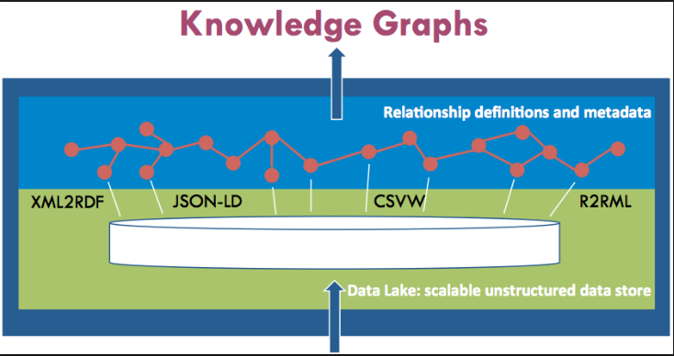
V1 -Variety

Slide 15
Data Lakes and High performance OLTP,OLAP
Advanced Machine Learning and Human Crowd Sourcing
Big Data in Future of Computer Science
Array Database +Linear Algebra Environment
New Concurrency Control Mechanism

Slide 16
Reference
Dunning T, Friedman E. 2015.Real World Hadoop. O'Reilly.
T. White. 2012. Hadoop: The Definite Guide. O'Reilly
Apache Sotware Foundation,Coudera. 2016.
https://www.cloudera.com/ [online]

Slide 17
Thank you!

